Slide 1

DEPARTMENT OF ELECTRONICS AND COMMUNICATION ENGINEERING
PROJECT TITLE :
PIZZA DELIVEY APPLICATION USING SALESFORCE DOMAIN
Busani Vamsi Krishna - 218X1A04A9
GUIDED BY : Dr.RANJITH PAINAM

Slide 2


Slide 3
What is Salesforce?
Salesforce is the world's 1 customer relationship management (CRM) platform. We help your marketing, sales, commerce, service and IT teams work as one from anywhere.
Salesforce is an American cloud-based software company established by Marc Benioff headquartered in San Francisco, California, February 1999.

Slide 4
What is Cloud?
Cloud is remote servers hosted on the internet to store, manage, and process data, rather than a local server or a personal computer.
Cloud computing is the on-demand availability of computer system resources, especially data storage (cloud storage) and computing power

Slide 5
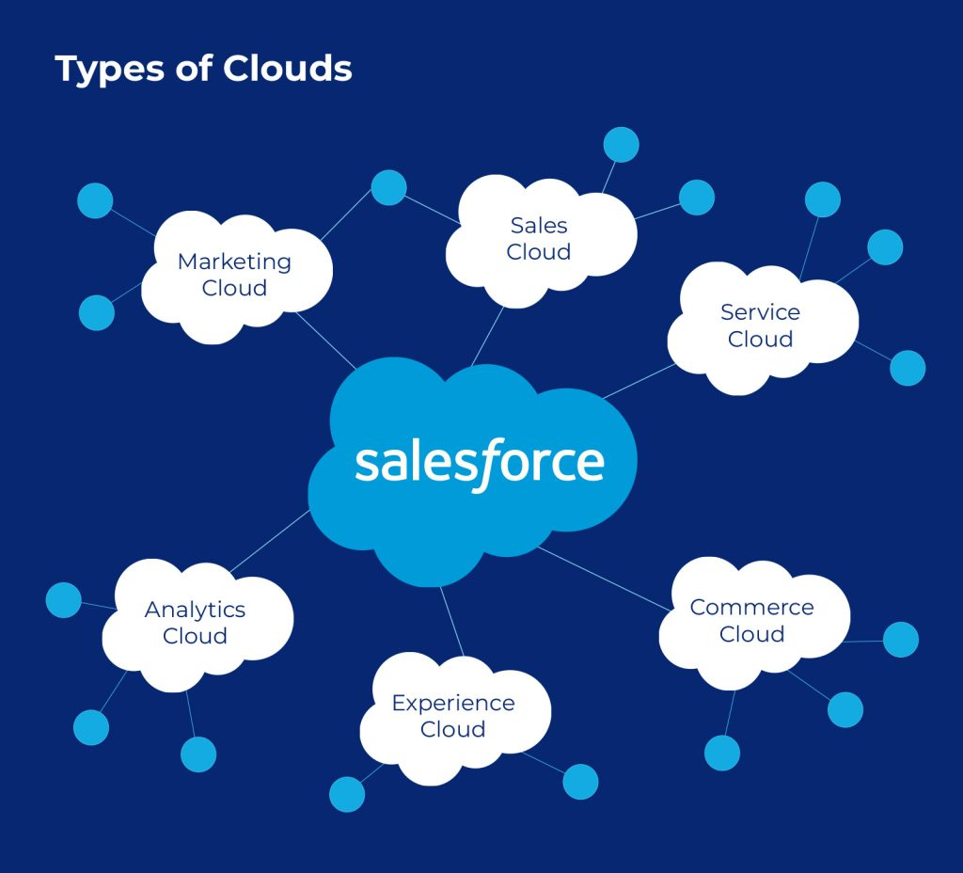

Slide 6
What is CRM?
Customer relationship management (CRM) is a technology for managing all your company's relationships and interactions with customers and potential customers.

Slide 7


Slide 8
What is Salesforce Developer?
A Salesforce developer is a special type of computer programmer who writes software on the Salesforce CRM platform or another piece of Salesforce cloud technology. This ranges from creating websites to developing apps.
A Salesforce developer's job is to analyze the processes in the company, design the CRM workflows in Salesforce, and also provide custom solutions for specific business requirements. They are the backbone of any enterprise to manage the old and new records of the company

Slide 9
Which language is used in Salesforce developer?
A Salesforce developer works with computer code like JavaScript and HTML on a daily basis.
To start coding in Salesforce using its programming language Apex (custom code) and Visualforce (user interface) you should start with Java. Java is a programming language that is widely used over multiple platforms and operating systems including Windows, Linux and Mac OS.

Slide 10


Slide 11
Advantage of Salesforce
Advantage of Salesforce:
Better Time Management: Time management is a huge benefit of Salesforce and one of the best ways to allow a business to grow.
Ultimate Accessibility
Increased Revenue
Greater Customer Satisfaction
Simple Account Planning
Trusted Reporting
Improved Team Collaboration

Slide 12
Disadvantage of Salesforce
Salesforce doesn't offer ready-to-set-up-and-go solutions for smaller niches(companies) like Commercial Real Estate, Investment Sales, or Construction.

Slide 13
Salesforce Developer Job Responsibilities
Meeting with project managers to determine CRM needs.
Developing customized solutions within the Salesforce platform.
Designing, coding, and implementing Salesforce applications.
Creating timelines and development goals.
Testing the stability and functionality of the application.
Troubleshooting and fixing bugs.
Writing documents and providing technical training for Salesforce staff.
Maintaining the security and integrity of the application software.

Slide 14
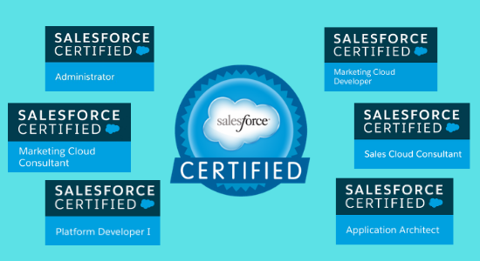

Slide 15
Pizza delivery is a service in which a pizzeria or pizza chain delivers a pizza to a customer. An order is typically made either by telephone, or over the internet, in which the customer can request pizza type and size, and other items to be delivered with it, commonly including soft drinks. Pizzas may be delivered in cardboard pizza boxes or delivery bags, and deliveries are made with either an automobile, motorized scooter, or bicycle.
Objectives: Business Goals:
Increase Sales: o Achieve a 20% increase in orders in the first 3 months. o Generate $250,000 in revenue in the first 6 months.
2. Customer Retention: o Retain 75% of customers after their first order. o Increase repeat orders by 30% using personalized marketing.
3. Operational Efficiency: o Reduce delivery time by 15% within 6 months. o Cut customer support response time by 20%.

Slide 16
Specific Outcomes:
Salesforce Integration: o Integrate the app with Salesforce to track customer data and orders. o Sync customer information between the app and Salesforce.
Order Tracking: o Use Salesforce to track real-time order updates and delivery status. o Allow customers to track their orders in real-time via the app.
Customer Engagement: o Set up personalized marketing using Salesforce to send targeted promotions. o Use Salesforce to send automated messages for new offers or discounts.
Customer Support: o Use Salesforce to manage customer service requests and resolve issues within 24 hours. o Implement a chatbot for quick responses to common questions.
5. Analytics & Reporting: o Use Salesforce to track key metrics like sales, customer satisfaction, and delivery times. o Generate monthly reports on app performance and customer trends.

Slide 17
Salesforce Key Features and Concepts Utilized:
Object
Tabs
Create App
Fields & Relationships
Record Types
Profile
User Adoption
OWD (Organization Wide Default)
Reports
Apex Trigger
Schedule Apex

Slide 18
Detailed Steps to Solution Design Objects Create a custom object for Customer Detail To create an object follow:
Click on the Gear Icon? From setup click on object manager
Click create, select custom object.
Fill in the label as "Customer Detail".
Fill in the plural label as "Customer Details".
Record name: "Customer Name"
Select the data type as "Text".
In the Optional Features section, select Allow Reports and Track Field History.
In the Deployment Status section, ensure Deployed is selected.
In the Search Status section, select Allow Search.
In the Object Creation Options section, select these options: Add Notes and Attachments related list to default page layout Launch New Custom Tab Wizard after saving this custom object
Leave everything else as is, and click Save.

Slide 19


Slide 20
Pizza delivery application
Team Members: Guided By:
B.VAMSI KRISHNA (218X1A04A9) DR. P.RANJITH SIR

Slide 21
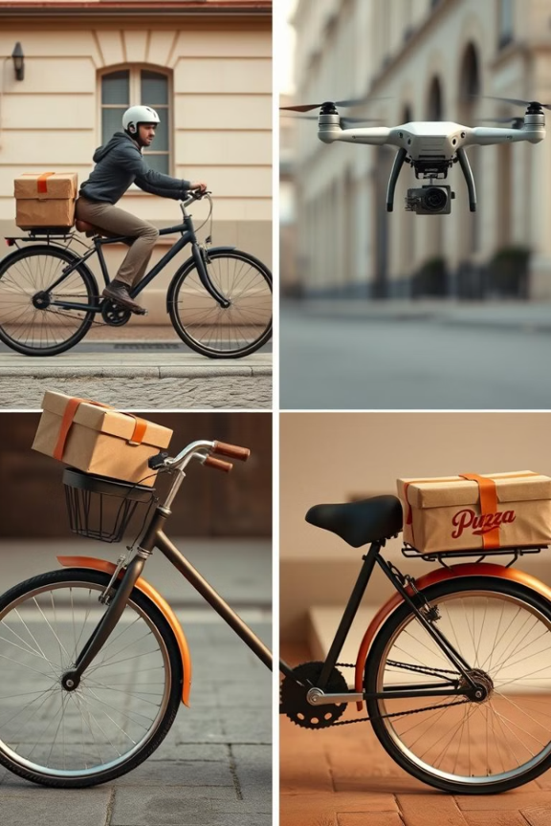
abstract
The pizza delivery application using salesforce is a smart solution that makes ordering and delivering pizzas faster and easier.
Traditional delivery systems often struggle with slow order processing, late deliveries, and no real-time tracking.
This application uses salesforce lightning components to improve the process.
Customers can place orders online, track their delivery in real time, and get personalized recommendations with AI-powered insights.

Slide 22
Table of contents
Introduction
Literature Survey
Existing System
Proposed System
Requirements
Technologies
System Architecture
Conclusion

Slide 23

Introduction
Ordering pizza should be quick, easy, and hassle-free! However, traditional delivery systems often struggle with delays, poor tracking, and inefficient management.
Our Pizza Delivery Application using Salesforce solves these problems by making the entire process smarter and faster.
By using Salesforce’s cloud technology, this app helps businesses improve efficiency, increase sales, and keep customers happy.
Say goodbye to late deliveries and hello to a smarter pizza experience.

Slide 24

Literature Survey
Third-Party Apps
Limited customization. High fees
In-House Systems
Lack of integration. Manual processes
Hybrid Models
Complex management
Inconsistent data

Slide 25
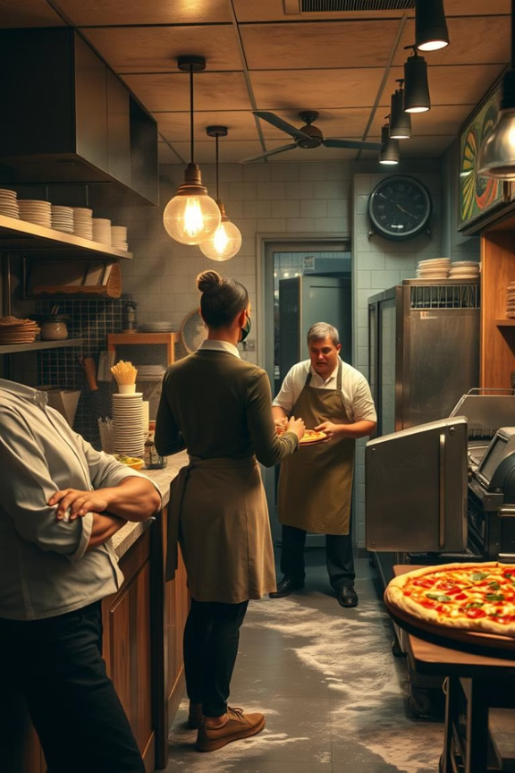
Existing System
Disconnected Systems
Lack of integration leads to data silos
Inefficient Processes
Manual tasks cause delays and errors
Poor Customer Service
Limited visibility impacts customer satisfaction

Slide 26
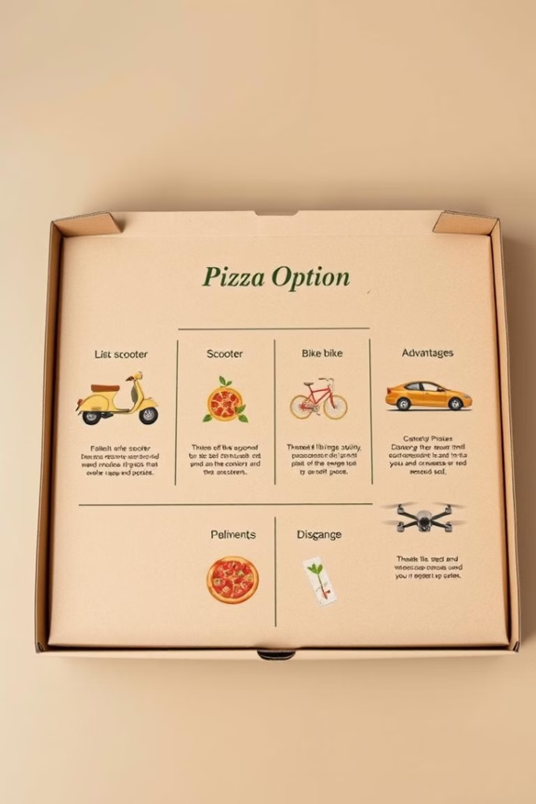
Proposed System
Order Management
Delivery Tracking
Customer Service

Slide 27
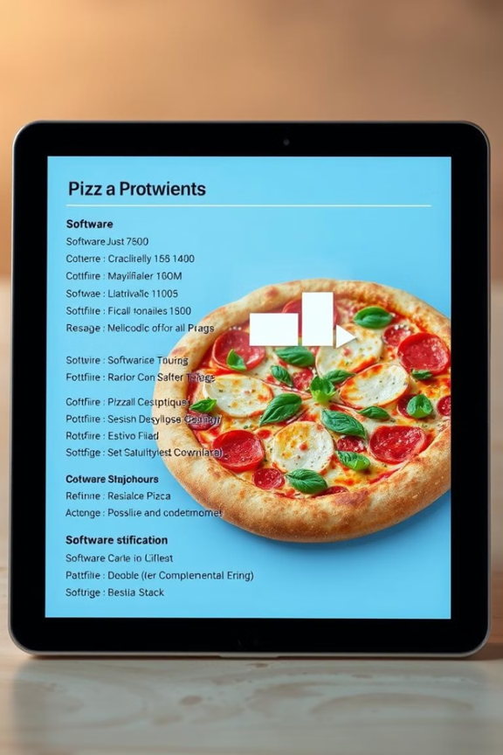
Requirements
Software
Salesforce Sales Cloud
Salesforce Service Cloud
Custom Delivery App
Hardware
Delivery Vehicles
Mobile Devices
GPS Tracking

Slide 28
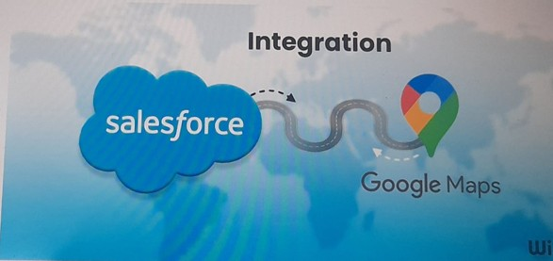
Technologies
Salesforce Lightning Components – Build a responsive and interactive UI.
Salesforce Service Cloud – Manage customer queries and support.
Salesforce Marketing Cloud – Send personalized offers and promotions.
Salesforce Field Service – Optimize delivery routes and driver assignments.
Google Maps API – Enable real-time location tracking and navigation.
Payment Gateway Integration – Support secure online transactions (PayPal, Stripe, etc.)

Slide 29
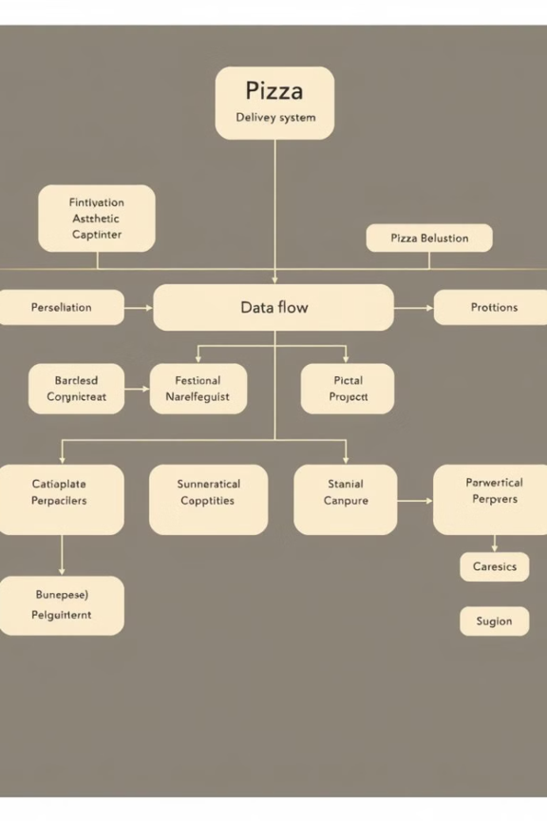
System Architecture
Order Placement
Customer places order online or via phone
Order Processing
Order is processed in Salesforce
Delivery Dispatch
Driver is assigned via Salesforce
Delivery Confirmation
Customer confirms delivery.
Payment processed.

Slide 30
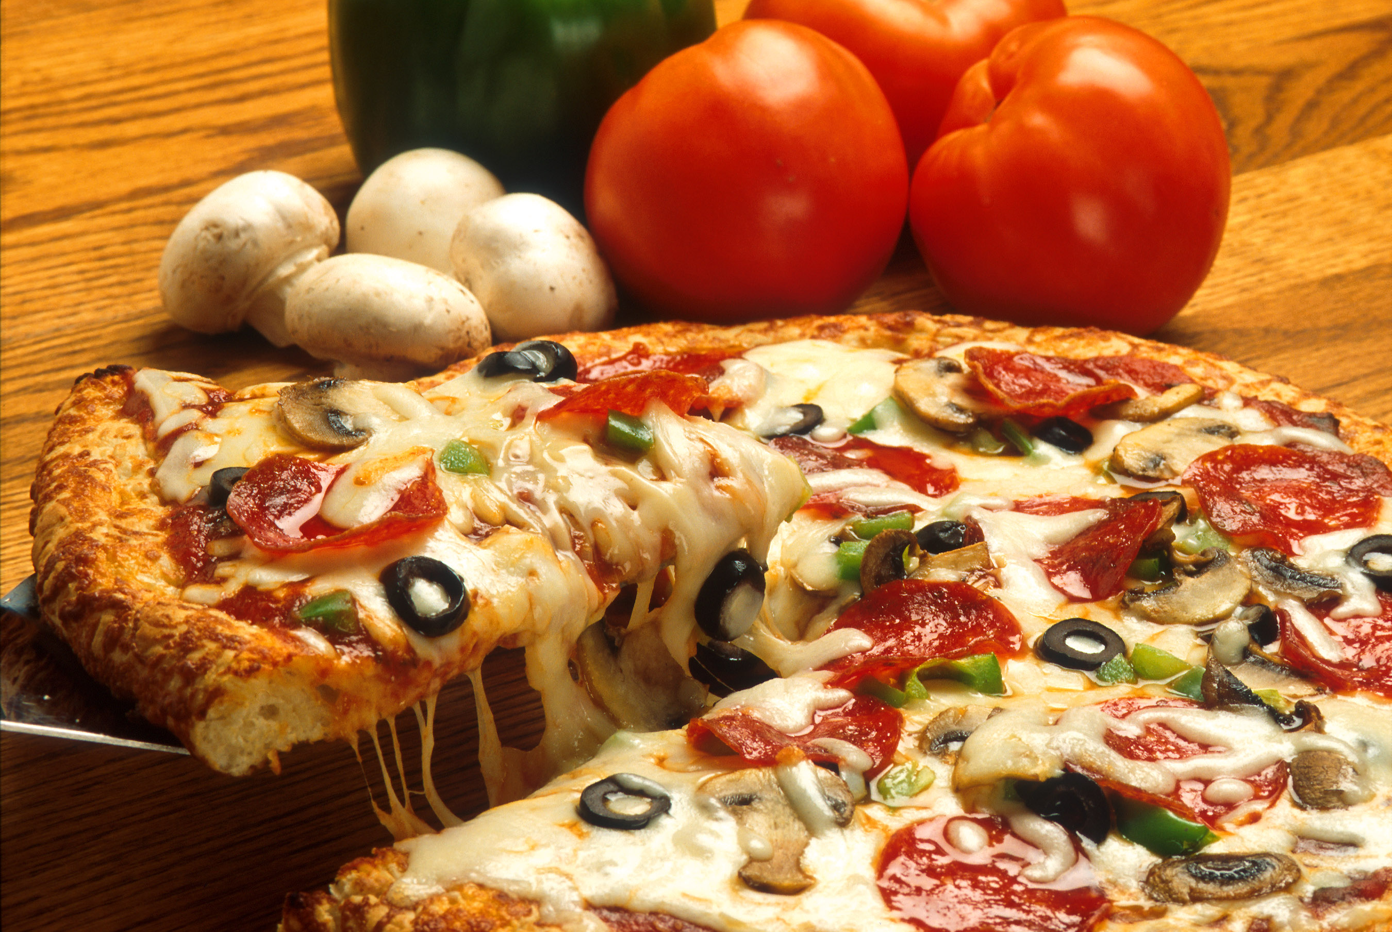
Conclusion
Increased Efficiency
Improved Customer Satisfaction
Data-Driven Insights
This Photo by Unknown Author is licensed under CC BY-SA

Slide 31
